Slide 1
MILESTONE-2 PROJECT
End-to-End CI/CD Pipeline on AWS Using Jenkins, GitHub, Maven, Docker, ECR, and Kubernetes
HARIRAM S
PS.NO: 10835505
01 JULY 2025

Slide 2
Problem Statement:
Create an end-to-end CI/CD pipeline in AWS platform using Jenkins as the orchestration tool, GitHub as scm, maven as the build tool, deploy in a docker instance and create a docker image, store the docker image in ECR, Kubernetes deployment using ECR image. Build sample java web app using maven.

Slide 3

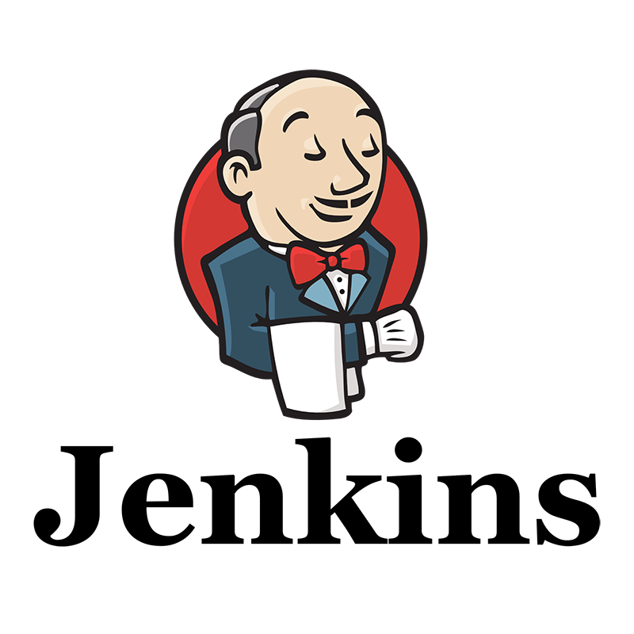
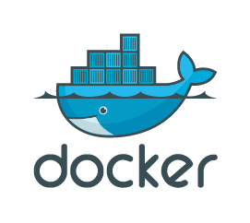
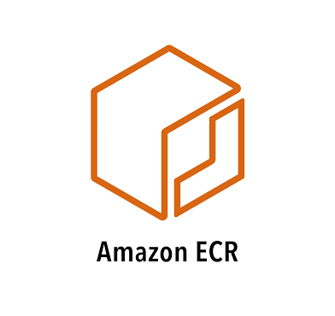
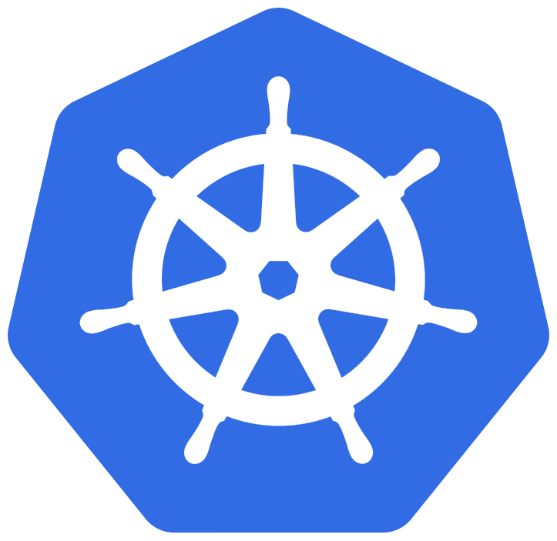

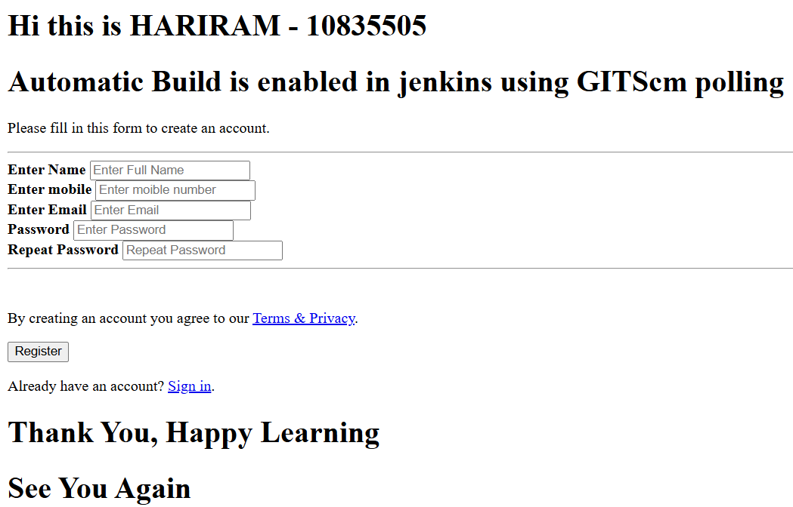

WORKFLOW
Web page displayed for test
Tomcat
server
(SSH-KEY)
Image push from docker to ECR
Project is build using Maven
(SSH-KEY)
Image pull from ECR
(WEBHOOK)
(SSH-KEY)
EKS-server
Java code is pushed into git repo
GitHub
Pods are deployed
(SSH-KEY)
Final output is displayed on web in 8080 port
Cluster
Dev-server

Slide 4
CI/CD Pipeline Setup Approach:
Requirements:
Git (Local Version Control System)
GitHub (Distributed Version Control System)
Jenkins (Continuous Integration Tool)
Maven (Build Tool)
Docker (Containerization)
Kubernetes (Container Orchestration)

Slide 5
Step 1: CI/CD with GitHub, Jenkins, Maven & Tomcat
Install & Configure Jenkins
Install & Configure Maven and Git
Set Up Apache Tomcat Server
Integrate Jenkins with GitHub, Maven, and Tomcat
Create CI/CD Jobs in Jenkins
CI Job: Build code using Maven
CD Job: Deploy to Tomcat
Test Deployment on Tomcat

Slide 6
Step 2: CI/CD with GitHub, Jenkins, Maven & Docker
Set Up Docker Environment
Create Docker Image and Run Container
Integrate Docker with Jenkins
Create Jenkins CI/CD Job
CI Job: Build code with Maven
CD Job: Package into Docker image and deploy to container

Slide 7
Step 3: CI/CD with GitHub, Jenkins, Maven & Kubernetes
Set Up Kubernetes Cluster (e.g., EKS)
Write Kubernetes Manifest Files
Deployment
Service
Pod specifications
Create Jenkins CI/CD Job
CI Job: Build code with Maven
CD Job: Deploy to Kubernetes using kubectl

Slide 8
Step 4: Final Deployment & Validation
Deploy Artifacts to Kubernetes
Ensure Docker and Kubernetes Artifacts Contain Required Code
Trigger Jenkins Build
Verify Pod Creation in Kubernetes
Access Application via Kubernetes Service IP
Copy service IP
Paste in browser to validate output

